Slide 1
Customer churn analysis for a mobile network company Team -5
Problem Statement:
A wireless services company wants to reduce its customer churn rate as retaining existing customers is more economical than obtaining a new customer.
In our analysis, we study customer behavior and usage trends across 3 months to come up with insights & recommendations to reduce customer churn.
Kavyasree Kanakaveedu peta
Chethana Bohini Srinivas
Karthik Lalisetti

Slide 2
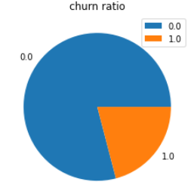
Summary of the data set:
Initial Dataset:
Dataset has 6th,7th and 8th months of customer usage records with churn behavior in 9th month.
Dataset has 21 categorical columns and 175 continuous columns.
The columns mainly indicate customers SMS, call , reload and data usage in the past three months.
Data set shape : (66469, 196)
Final dataset :
Data shape after preprocessing is (66469,70)
Target variable: Churn of the customer in 9th month.
1 indicates that customer is leaving.
0 indicates that customer is staying.

Slide 3
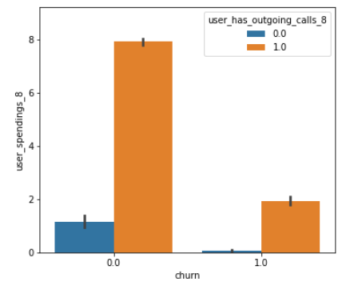
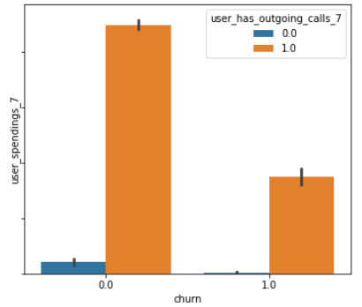
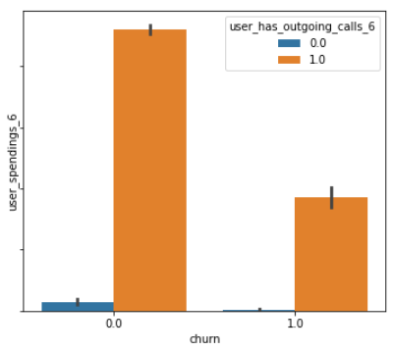
Customer behavior:
The user spending for consumers who made outgoing calls and who left the company is decreasing
gradually from 6th to 8th month.
Among the customers retaining also user spending with outgoing calls declined a little.
But relatively user spending for customers who are not leaving the company but do not have outgoing calls is increasing each passing month.
This might be due to the increase in data usage.
Observations and Recommendation:
To increase the user spending among non-churned customers and to retain existing customers
who have no outgoing calls, including plans that offer better coverage on data and less coverage on outgoing calls with relatively lower plan prices depending on their previous user spending.

Slide 4
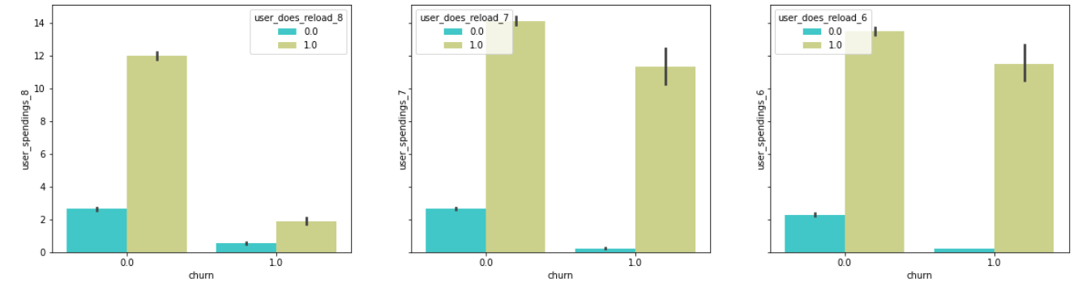
Customer behavior:
User spending and re-load have been drastically decreased in the month prior
to churn(August) for both continuing and leaving customers.
This may be due to user dissatisfaction during the period or change in coverage plans.
Observations and Recommendation:
The company should try to improve customer experience through better network coverage.
Offering discounts for each reload and decreasing per call, per SMS charge would help retain
customers and also attract new customers.

Slide 5
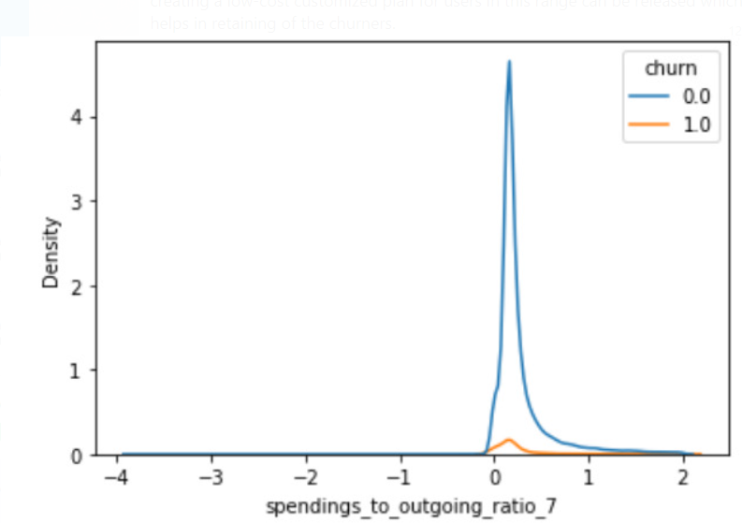
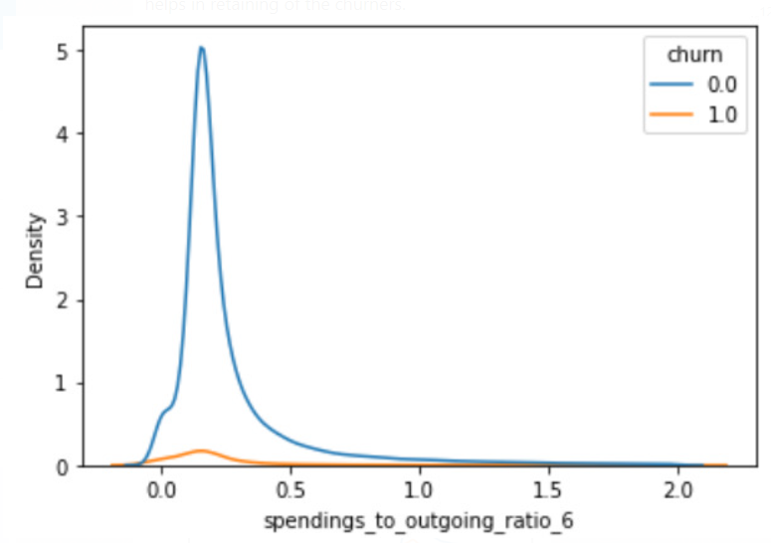
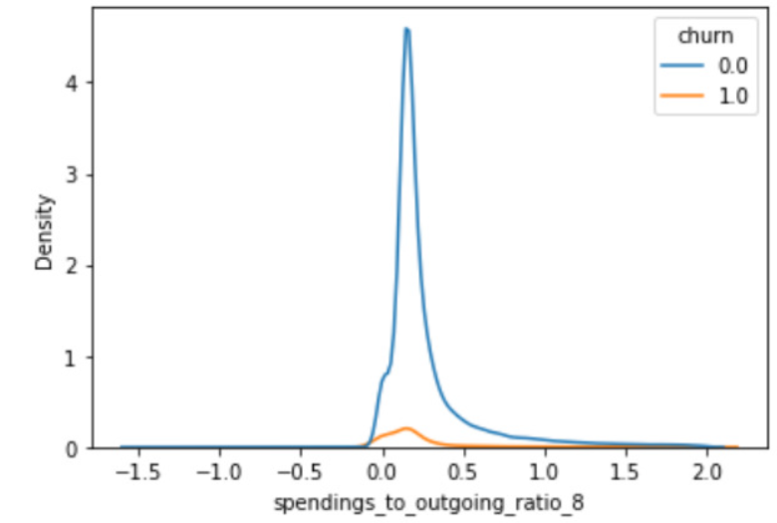
Customer behavior:
The majority of the customers spent 0 to 0.5 units of currency for each minute of outgoing call. From the graph, we can see there are more customers in this range who are both
churners and non-churners. But relatively, churners are more.
Observations and Recommendation:
An optimal usage plan should be implemented such that the per minute price should be less
than 0.3. This will affect the customer base in such a way that non-churners
spending's would be decreased to a certain extent and yet we will retain all the churners but provide them low-cost plan and let them use more.

